Slide 1

Project
On
Attendance Management System
Presented By:
Rupali Khairnar

Slide 2
Introduction
Attendance Management System is software developed for daily student attendance in schools, colleges and institutes.
If facilities to access the attendance information of a particular student in particular class .
The information is sorted by the operators which will be provided by the teacher for a particular class.
This System will also help in evaluating attendance eligibility criteria of a student.

Slide 3
Requirement
A according to the requirements the System
Daily Attendance
Attendance for present day
Attendance for absent day
Subject wise Attendance
Leave Report
Software Requirement:-
Eclipse IDE

Slide 4
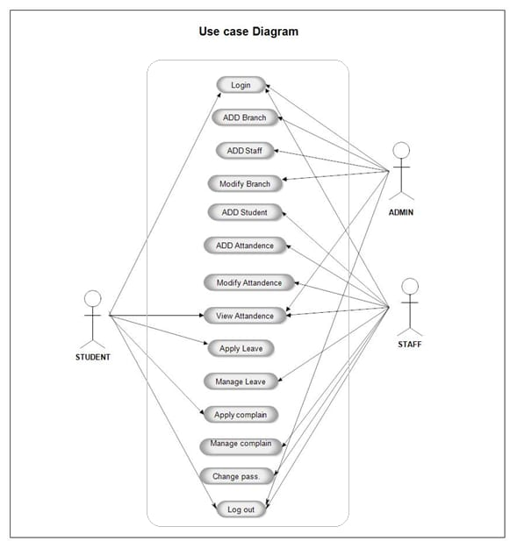
Usecase Diagram

Slide 5
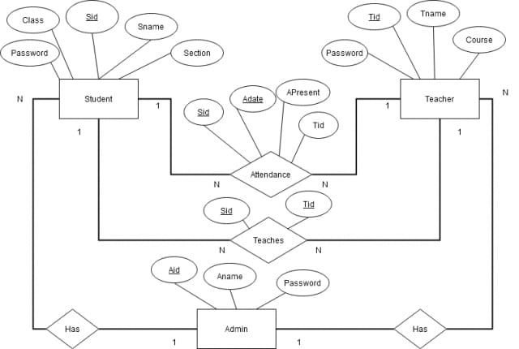
Entity Relationship Diagram

Slide 6
Modules
System
Attendance
Student
Teacher
We can perform different operation in the Attendance Management System enter no subject, subject ,teacher, present day, absent day,

Slide 7
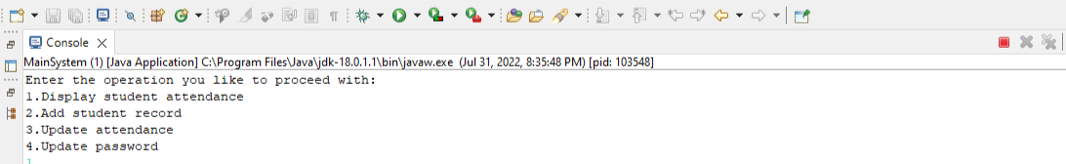
Output of Project
Showing all menus:

Slide 8
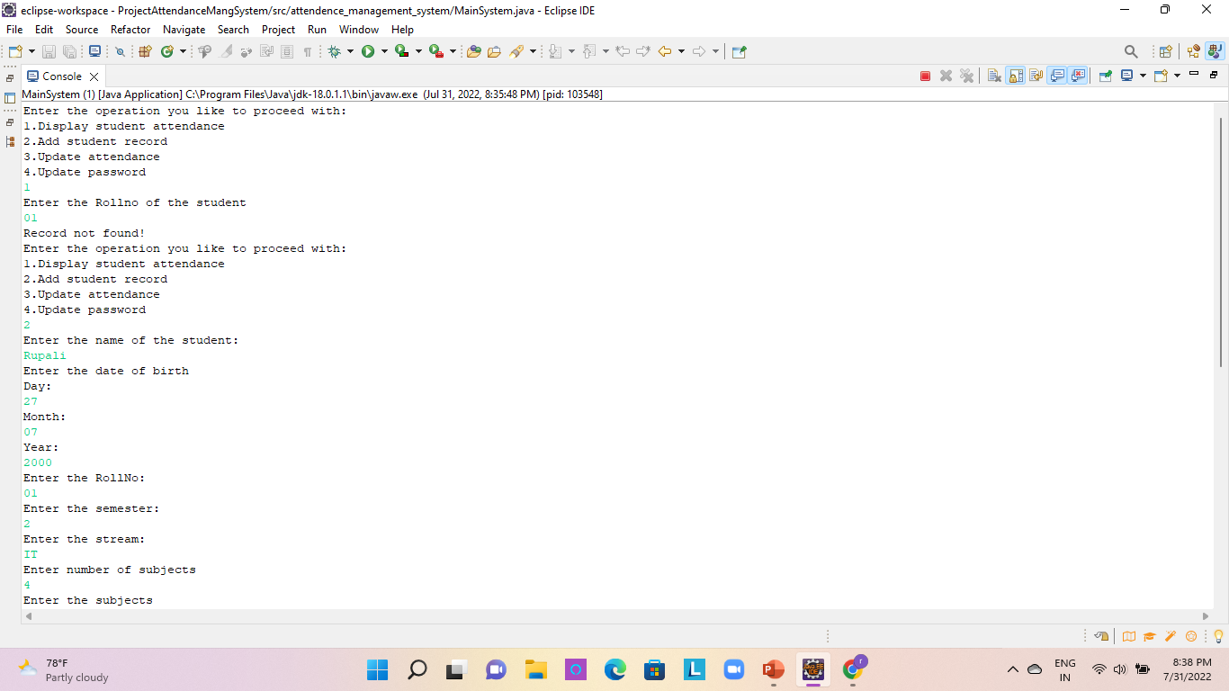
Add
Adding Student Record

Slide 9
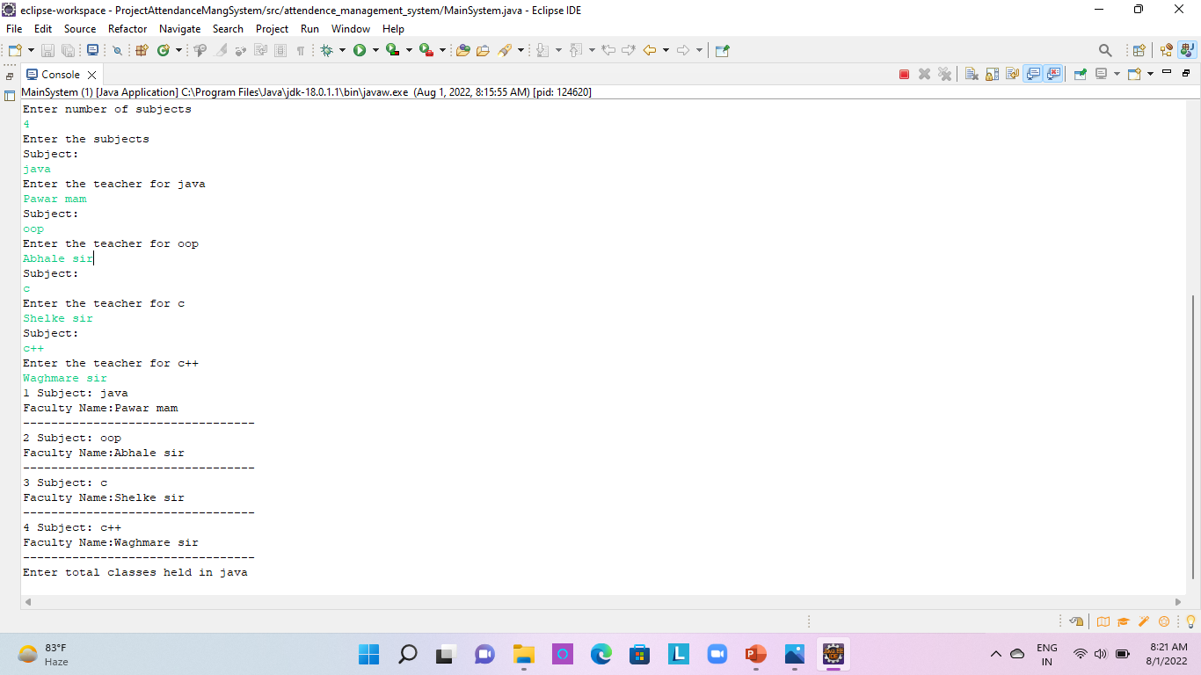
Adding Subject and Teacher

Slide 10
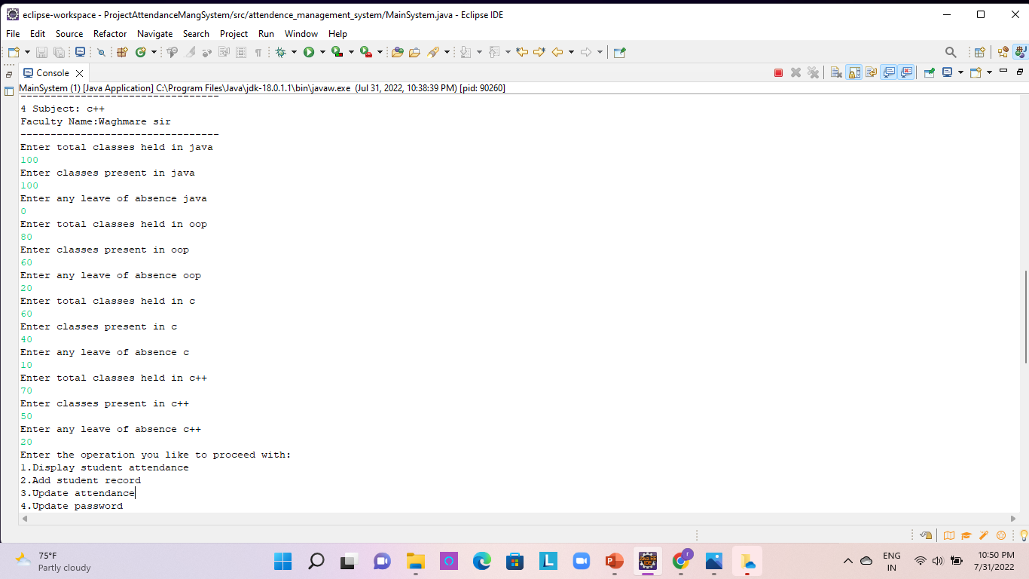

Slide 11
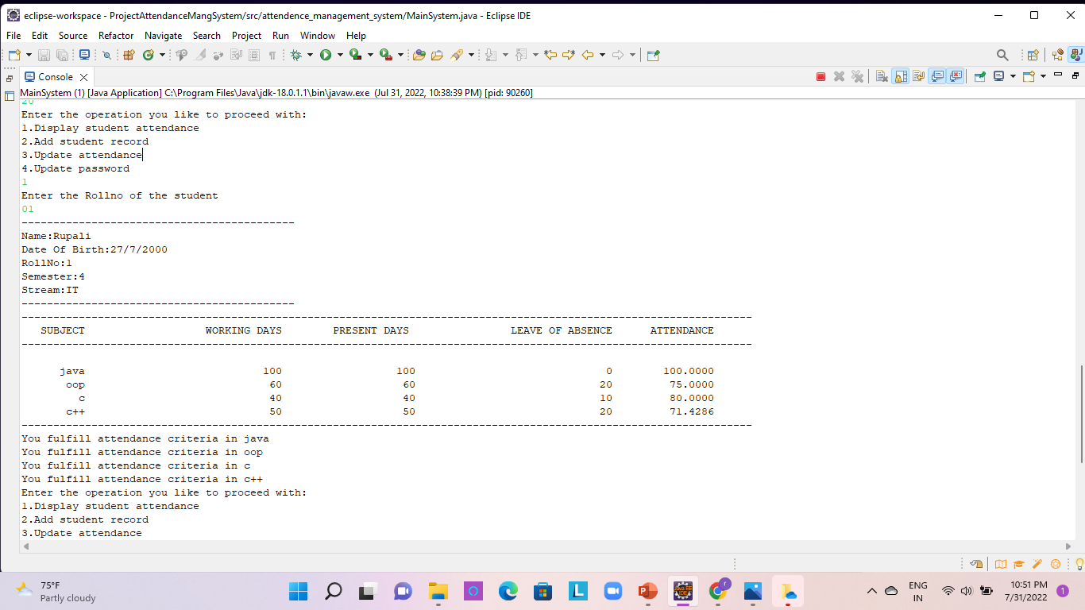
Display Student Attendance

Slide 12
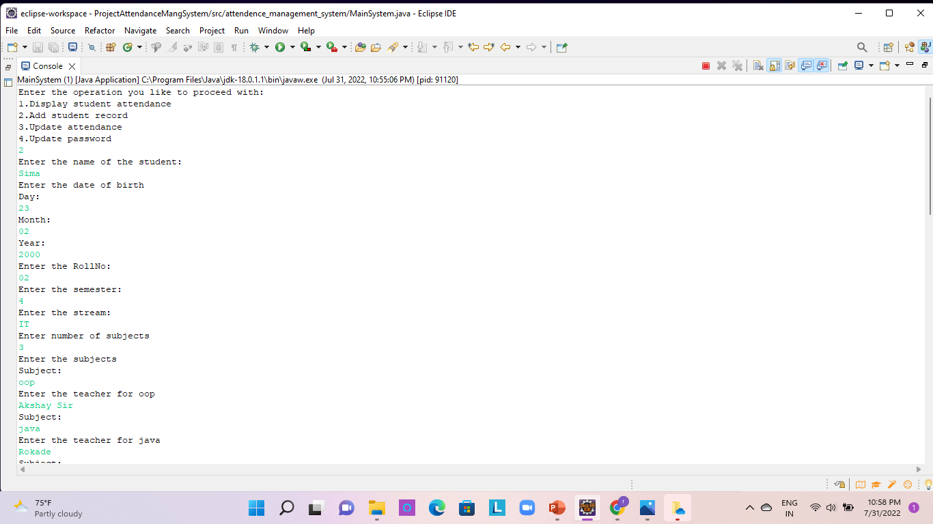
Adding New Student

Slide 13
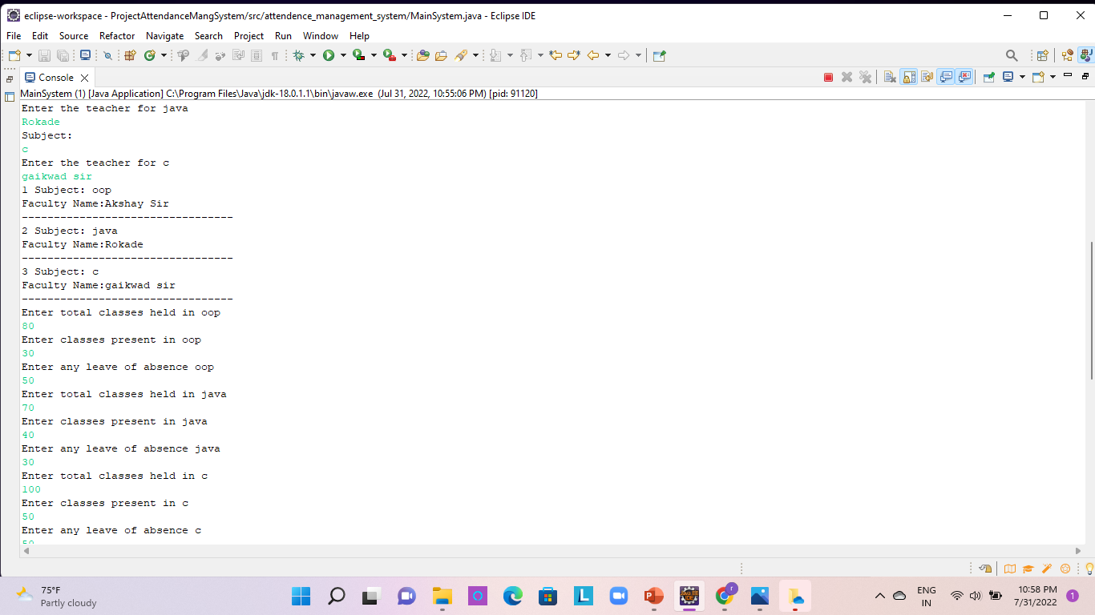

Slide 14
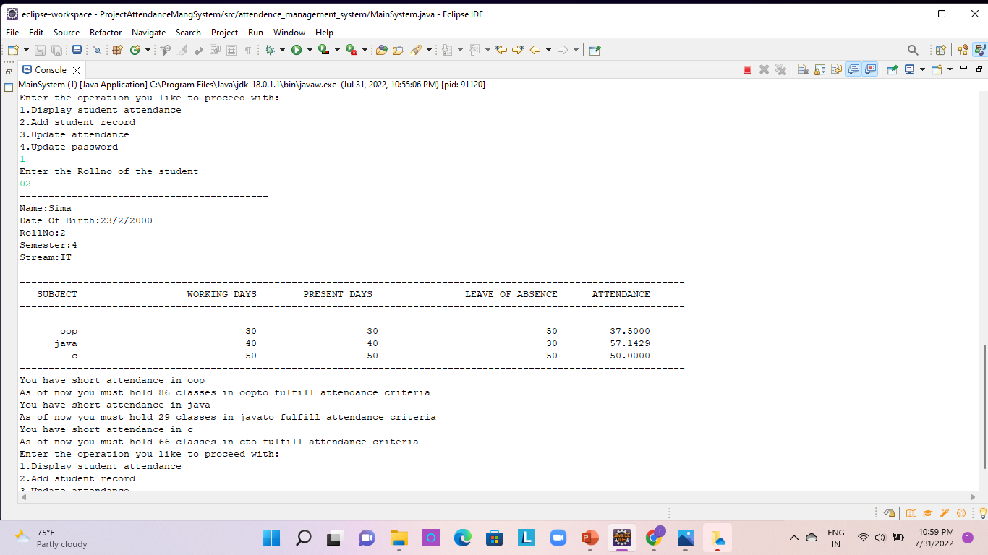
Display Second Student Attendance

Slide 15
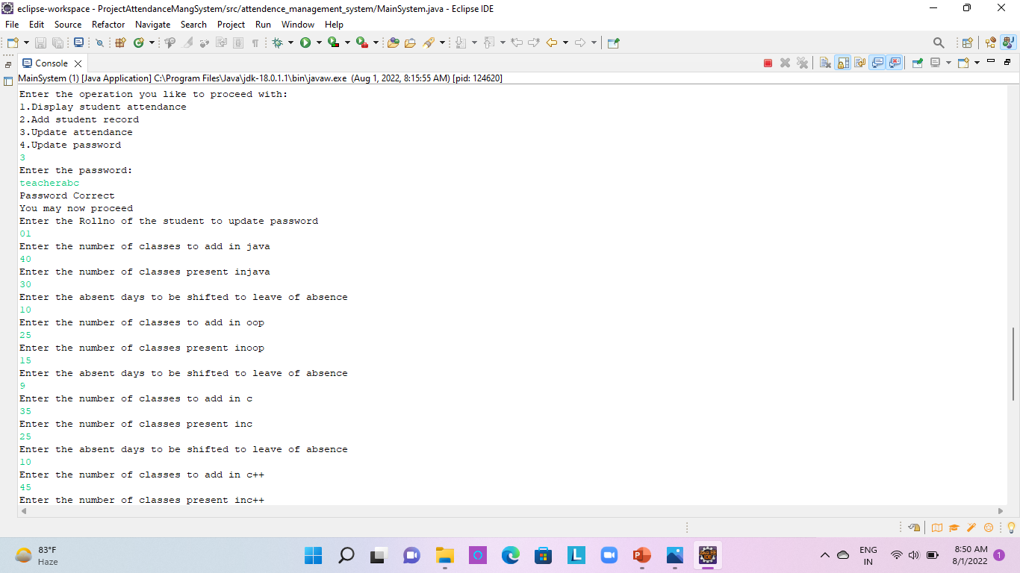
Update Attendance

Slide 16
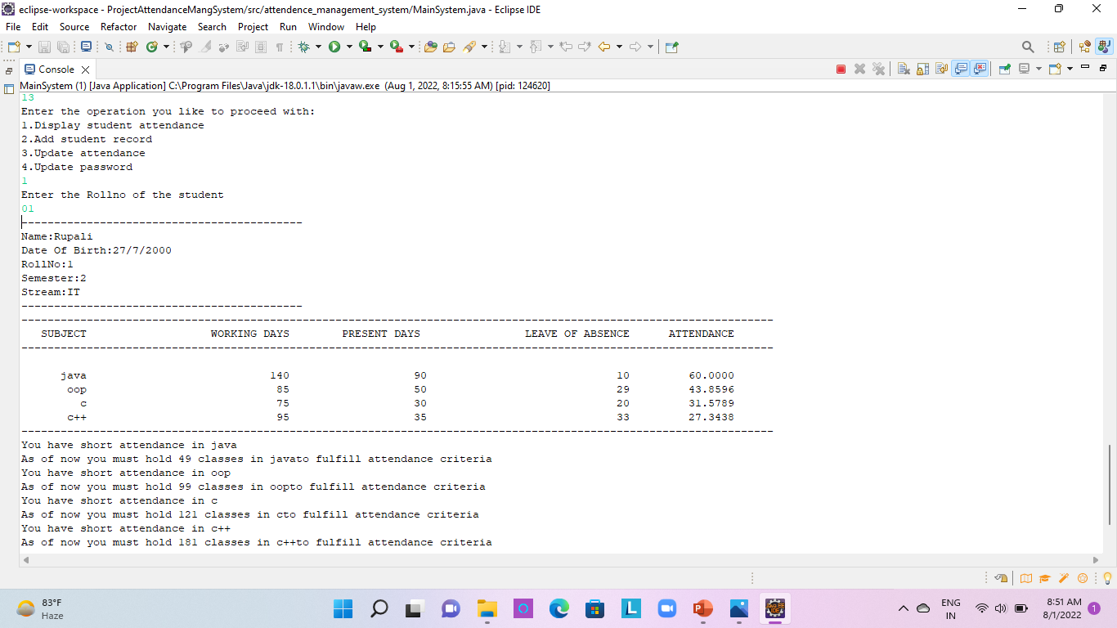

Slide 17
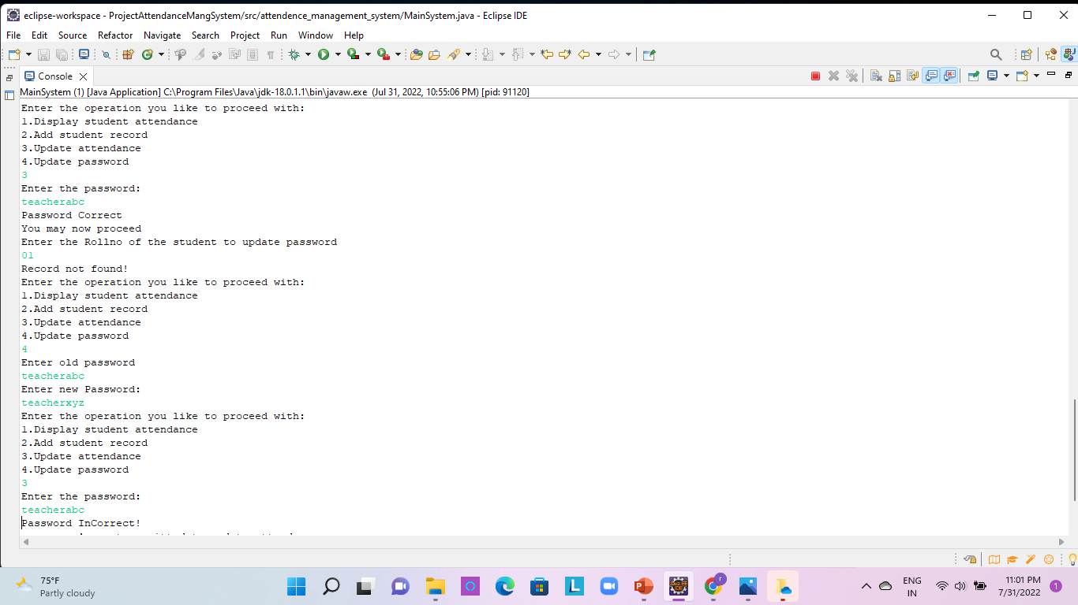
Update Password

Slide 18
Conclusion
The Attendance Management System is designed in such a way that it meets the requirement of the System .
The System Maintain the record of students with ease and accuracy which is important keys of this project .Thus it is helpful for all students ,faculties ,and admin of the institution.

Slide 19


